Slide 1
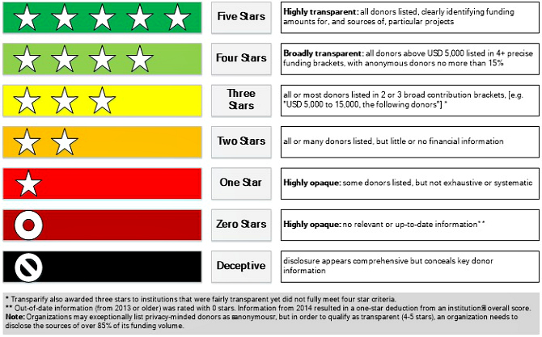
Customer Ratings Prediction
Submitted by:
Mallu Deepthi
This Photo by Unknown Author is licensed under CC BY

Slide 2
PROBLEM STATEMENT
Text communication is one of the most popular forms of day to day conversion. We chat, message, tweet, share status, email, write blogs, share opinion and feedback in our daily routine.
All of these activities are generating text in a significant amount, which is unstructured in nature. In this area of the online marketplace and social media. It is essential to analyze vast quantities of data, to understand people’s opinion.
NLP is applicable in several problematic ways from speech recognition, language translation, classifying documents to extract information. Analysing, customer reviews is one of the classic examples to demonstrate a simple NLP Bag-of-words model, on customer reviews.
As per the business problem one has to scrape the reviews and ratings on products from different ecommerce websites given by the customers and build machine learning models such that on the type of review the model has to predict the type of rating.

Slide 3
Review of Literature
When it comes to making decisions, we humans aren’t always independent thinkers. From buying our morning coffee to big-ticket items like a new car, we depend on our network’s opinions, advice, or perspectives for making the right decision.
With the internet, those networks get way, way bigger. We’re no longer confined to just friends, family, and co-workers. we can see what people all around the world think with just a quick Google search.
And these customer reviews hold serious weight with shoppers. Online reviews either positive or negative can impact over 93% of consumers’ decisions.
While reviews can accumulate on their own, they shouldn’t exist in a vacuum. Knowing how to ask for reviews, leverage them to get more business, and respond to less-than-favourable customer testimonials can improve your business image and land you more long-lasting customers.

Slide 4
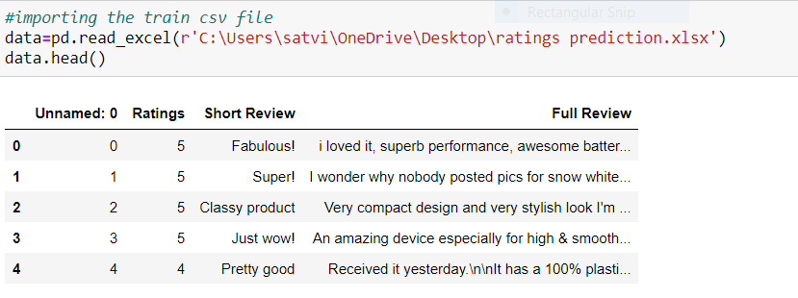

Data Sources and their formats
The dataset consists of 20568 rows and 4 columns.

Slide 5
Data Pre-processing
Data pre-processing is the data mining technique that involves transforming raw data into an understandable data format. So, in data pre-processing technique first step is to import data and the libraries to be used in model building.
In the dataset there is a column of long review text column, which cannot be understand by the machine, so by using the Natural language processing techniques (NLP) we need to pre-process the data and apply various techniques to convert the text data and analyse the data. As a data scientist, the aim is to filter out these words from the ecommerce websites and predict the ratings (1 to 5) based on the reviews given by the customers.
Used TFIDF vectorizer to convert the text to vectors, and split the data into test and train and trained various Machine learning algorithms.

Slide 6
Data Inputs- Logic- Output Relationships
The input data for the processing and getting the output is converted in to the numerical forms or data words, in to the vector form and fed to the model one by one which analyses by the model providing the certain score through the medium of performance metrics.
There are some missing values in columns, I have filled them using imputing methods and In data cleaning I have dropped the unknown column and short review columns as they give no information. After dropping I pre-processed the ratings columns which has different classes with same values.
Cleaning the textual data involves the removal of unwanted space, punctuation, numbers etc and then converted upper case letters to lower case and removed stop-words from the text.

Slide 7
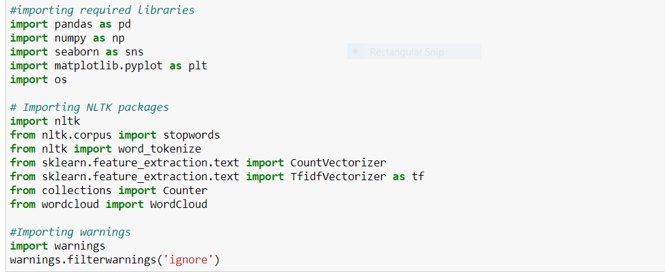
Hardware and Software Requirements and Tools Used

Slide 8
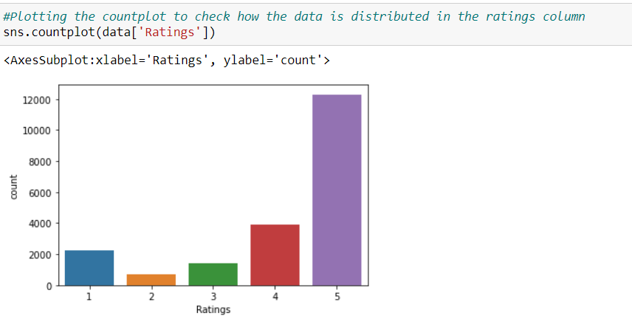
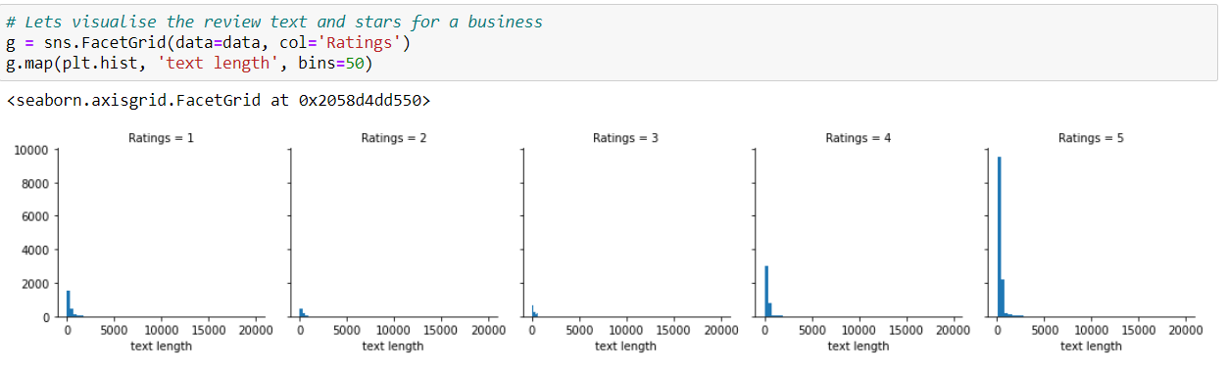
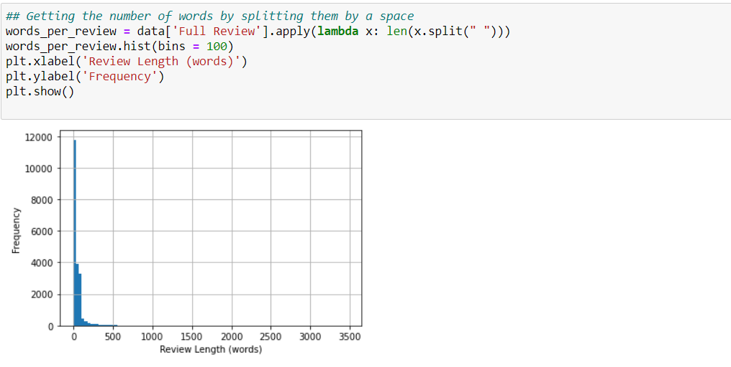
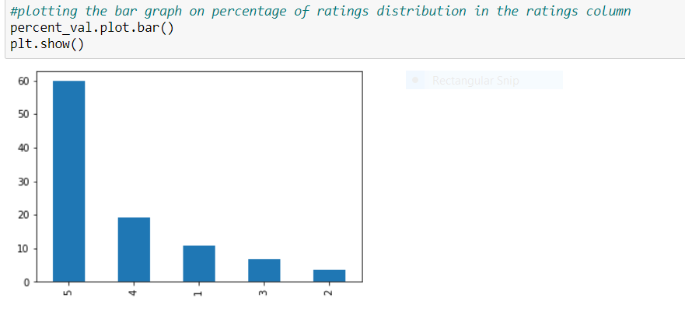
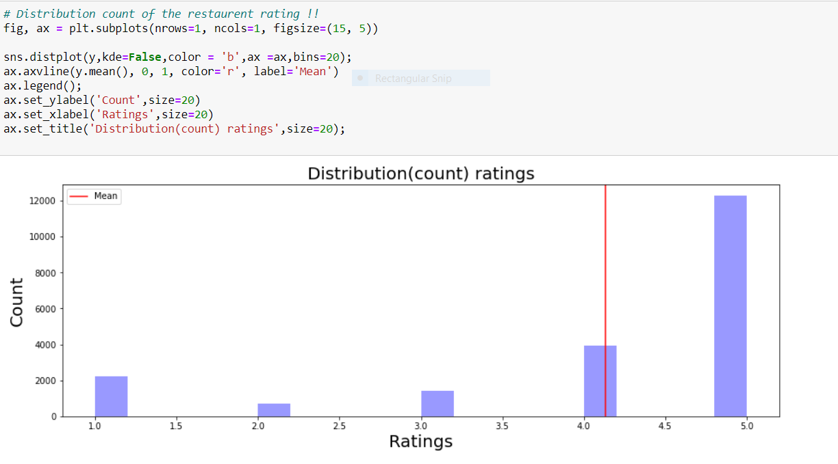
Visualization

Slide 9
MODEL/S DEVELOPMENT AND EVALUATION
LR=LogisticRegression()
KNN=KNeighborsClassifier()
MNB=MultinomialNB()
DT=DecisionTreeClassifier ()
SVC=LinearSVC()
Rf=RandomForestClassifier()

Slide 10
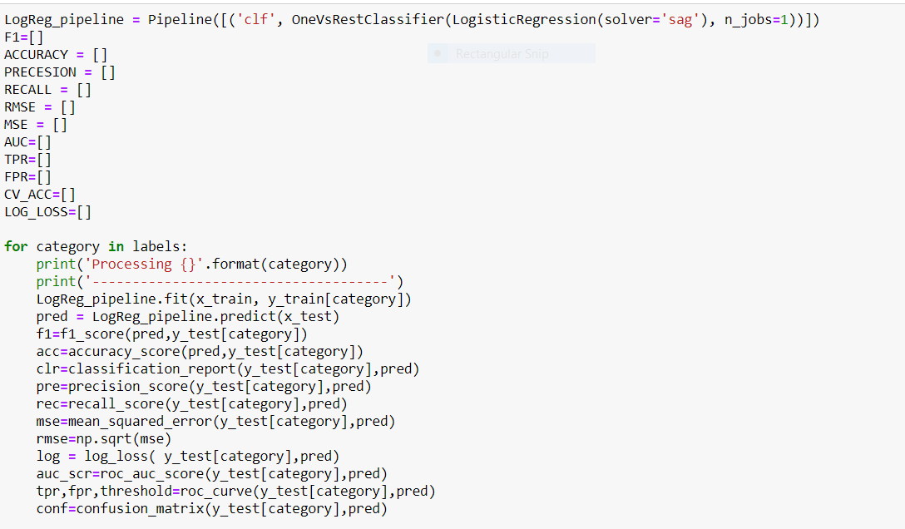
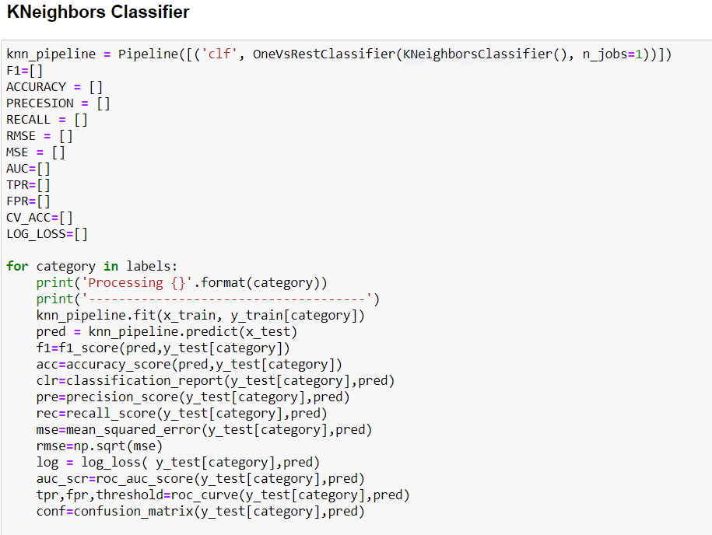
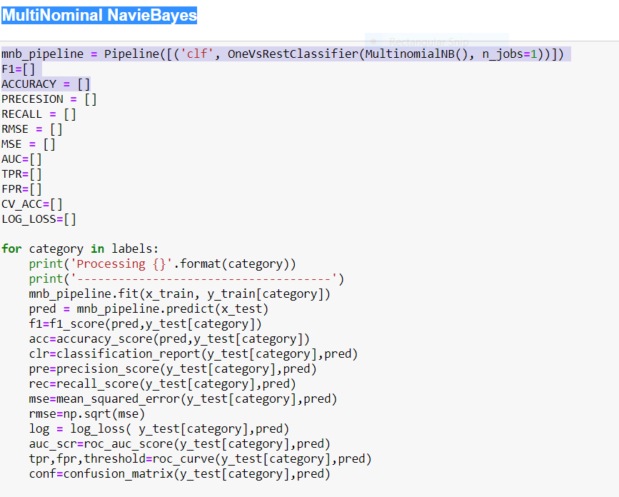
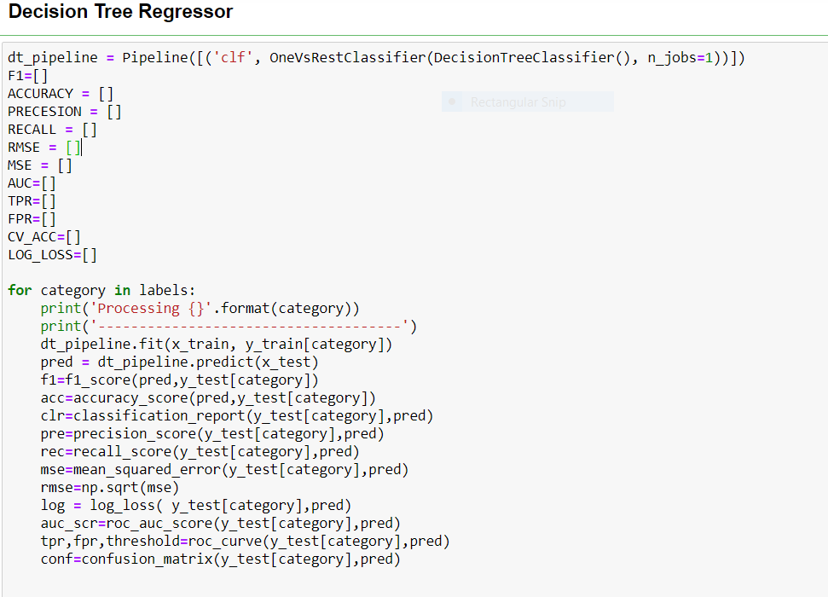
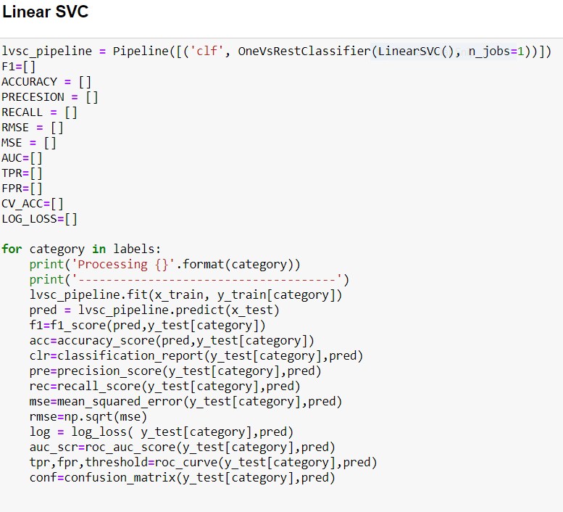
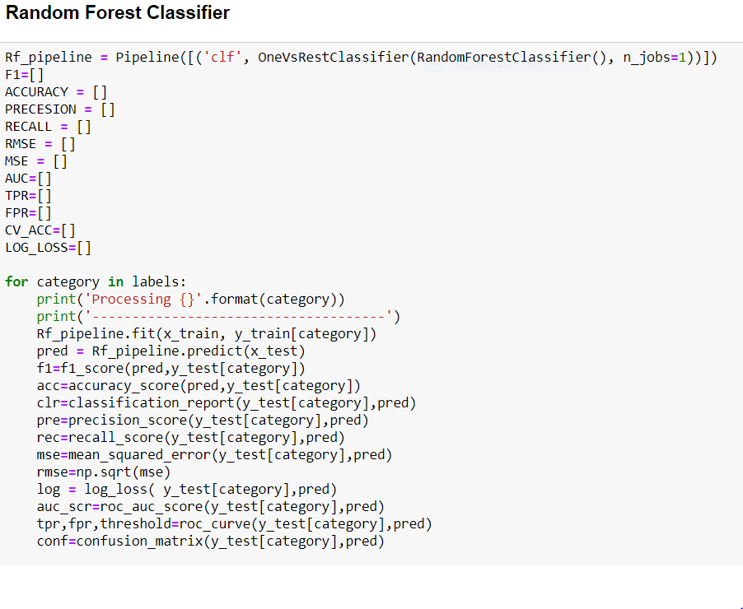
Testing of Identified Approaches (Algorithms)

Slide 11
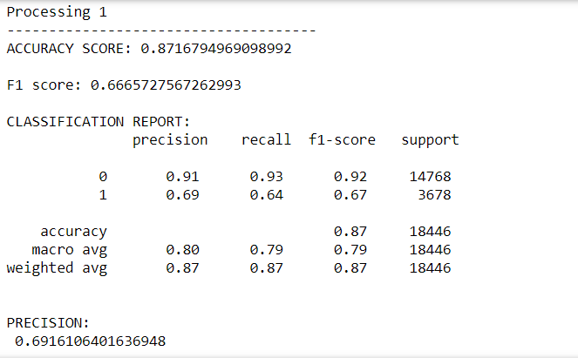
Metrics for success in solving problem under consideration:
For solving the problems and understanding the result of each algorithm, we have used different metrics like:
a) Accuracy Score
b) Classification Report
c) Confusion Matrix
d) Log Loss
e) Roc-Auc
Key metrics are F1-score, Precision, Recall and Roc-Auc Score.

Slide 12
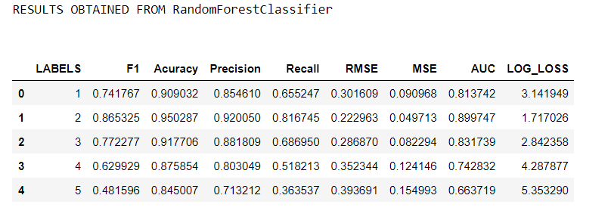
Interpretation of the Results
As our target feature is imbalanced which means that alone accuracy score will not give best results but instead accuracy, we are using the classification report log loss score, Roc-AUC-score and confusion matrix to find the best algorithm. So, I have selected Random Forest Classifier which has good ROC_AUC score, accuracy, RMSE Score is less and log loss is less compared to all the other models.
.

Slide 13
Key Findings and Conclusions of the Study
From this project I have learnt, new techniques and ways to deal with text data which is uncleaned and found a solution to deal with multiple target variables using NLP Techniques.
Tools used for visualizations, gave me a better understanding of dataset and used different classification algorithms to predict our target.
So, after applying many models, Random-forest classifier gave me the best results compared to other models in terms of performance and evaluation.

Slide 14
Limitations of this work and Scope for Future Work
As I have used web scraping for data collection the data collection took long time and even tried to scrape the data from other websites but there are no ratings and reviews much. So may be in future all the ecommerce websites should design themselves to get reviews and gain Ratings from the customers for the purchase of products.
So that we can collect more data which helps us to get better insights and results from the text data in future and predict ratings with minimum errors.

